Slide 1

Real world applications and explanations of Natural Language Processing
Dr Nathan Fox AI in Science and Engineering Summer Academy 2023

Slide 2

Session Overview
Goal: to equip participants with foundational NLP knowledge and provide an overview of how state-of-the-art transformer models are revolutionizing NLP. By the end of the workshop participants should be confident in he coding methods needed to carry out NLP and applied the methodologies learned today and apply them to their own datasets.
Schedule
1:00pm – 2:15pm
Session 4: Introduction to Natural Language Processing
2:30pm – 4:30pm
Session 5: Hands-on with Transformer models
Notes:
Very, very brief explanation.

Slide 3

About Me
Masters of Environmental Science (MEnvSci) and PhD in Ocean and Earth Sciences from the University of Southampton, UK
PhD Thesis “Social media, geodiversity and the provision of cultural ecosystem services” focused on assessing human-nature relationships through social media posts
AI in Science Postdoctoral Fellow, researching AI and social media for monitoring biodiversity
Notes:
Very, very brief explanation.

Slide 4
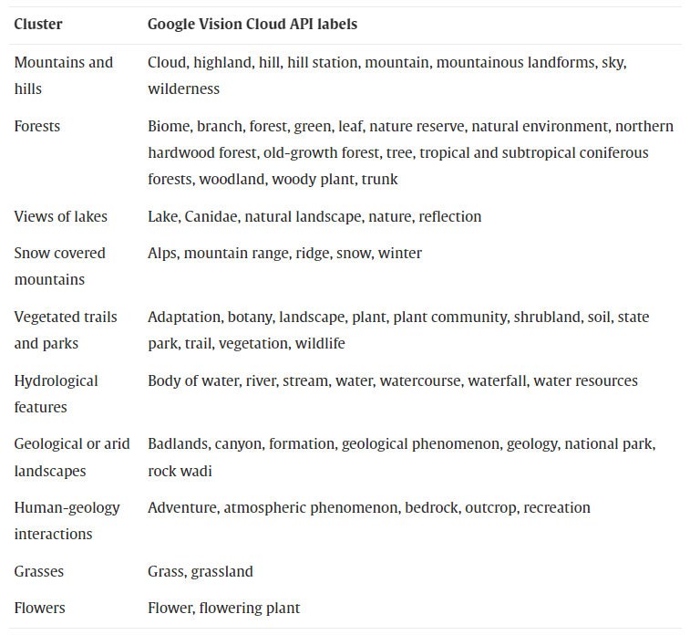
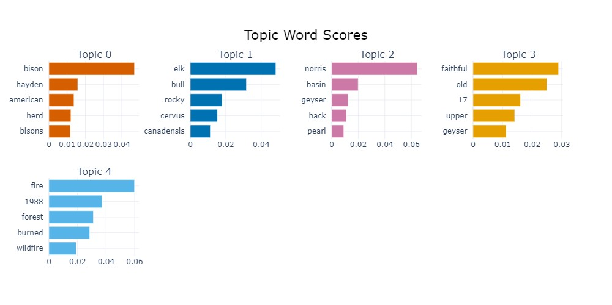
My NLP Research
Previous
Using social media posts to understand how people what discuss when having positive experiences in nature
Current
Using social media posts to understand how people talk about biodiversity monitoring and conservation
Image: https://www.sciencedirect.com/science/article/pii/S2212041621000863
Notes:
Using social media, primarily focusing on the implementation of simple statistical NLP - but that has all changed since I joined MIDAS - I am now harnessing cutting edge NLP methods thanks to transformers. The top example is from a paper i published during my phd - and the bottom is an output of a transformer model. They both give the same structure of output, however there is a main difference between the two. The first image took me weeks maybe even months to correctly paramatise and calculate. The bottom, took me about 20 minutes. By the end of the session, you should be able repeat this for any dataset of text. This is much easier to implement (and for me to teach) than the first clustering approach.

Slide 5
Introduction

Slide 6
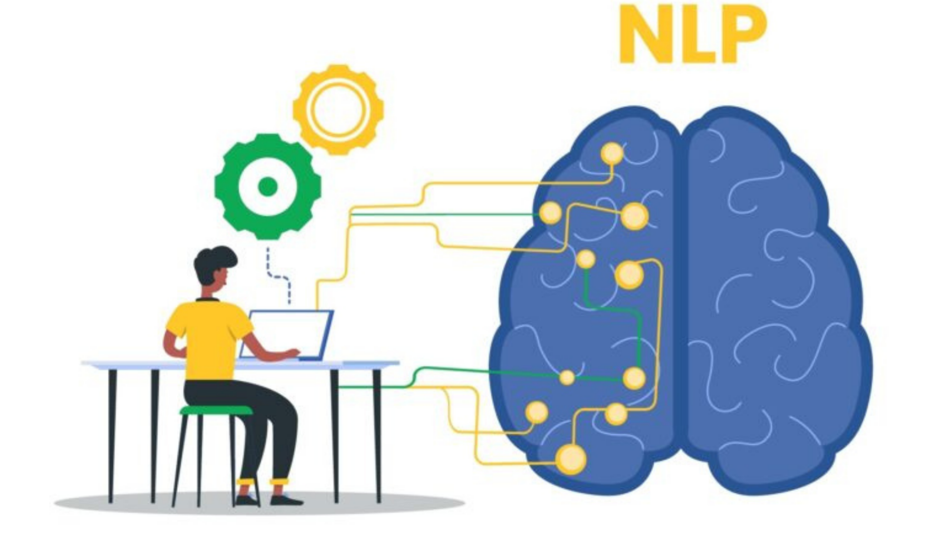
What is NLP?
NLP stands for Natural Language Processing. It is a subfield of artificial intelligence (AI) and linguistics that focuses on the interaction between computers and human language
Image: https://expersight.com/natural-language-processing-guide-use-cases/
Notes:
Natural Language Processing (NLP) encompasses the creation and deployment of algorithms and models that empower computers to comprehend, decode, and even craft human language with significance and practicality. In our discussion today, I'll be diving into a diverse array of NLP applications. Today we are going to explore a range of different NLP applications including word unmasking, text classification, named entity recognition, sentiment analysis, machine translation, question answering, and text generation

Slide 7
Sentiment analysis
Sentiment analysis (SA) involves extracting information pertaining to feelings or view-points
Traditional SA approaches include lexicon-based models and supervised machine ML. However, these lack the nuanced understanding of human language
The large training datasets and training techniques enable LLMs to represent sentiment from text more accurately. For example, BERT scores an extremely high accuracy when standard classification tasks
Sentence | Emotion
"I won the competition!" | Joy
"My heart is broken into pieces." | Sadness
"You betrayed my trust." | Anger
"This movie is so heart-warming." | Love
Notes:
Sentiment analysis, a cutting-edge technique in Natural Language Processing (NLP), focuses on deciphering the emotions and attitudes embedded within text. By employing sophisticated algorithms, computers become adept at discerning whether a piece of text exudes positivity, negativity, or neutrality. This insightful analysis not only provides a glimpse into the emotional tone of the text but also holds the potential to unlock valuable insights from social media, customer reviews, and various forms of written communication.

Slide 8
Named Entity Recognition
Sentences | NER
Apple Inc. is launching a new product. | ORGANIZATION
Jane visited Paris, the city of love. | PERSON, LOCATION
The Amazon River flows through Brazil. | LOCATION
The Prime Minister addressed the nation. | TITLE
Named Entity Recognition (NER) is a natural language processing task that involves identifying and classifying named entities within a text into predefined categories
Named entities are specific words or phrases that represent real-world objects, such as names of people, organizations, locations, dates, and other proper nouns
The main goal of NER is to recognize and label these entities accurately within a text. It helps in extracting important information from unstructured text
Notes:
Named Entity Recognition (NER) stands as a pivotal achievement in the realm of Natural Language Processing (NLP), enabling computers to identify and extract specific entities from text, such as names of people, organizations, locations, dates, and more. By employing advanced algorithms and linguistic patterns, NER enhances the machine's ability to comprehend the context and significance of these entities within the larger narrative. This capability finds immense utility in information retrieval, data categorization, and content summarization, paving the way for more efficient and insightful analysis of textual information across various domains.

Slide 9
Topic Classification
Topic classification is a natural language processing task that involves categorizing text documents into predefined topics or classes
The goal is to determine the main theme or subject of a given document based on its content
Topic classification is commonly used in text analysis, content filtering, information retrieval, and other applications where organizing large volumes of text into meaningful categories is necessary
Sentences | Classification
The majestic mountains stood tall and proud. | Nature
The lush green forest teemed with life. | Nature
The government implemented new tax reforms. | Politics
The candidate outlined their economic plan. | Politics
Notes:
Topic classification, a fundamental component of Natural Language Processing (NLP), involves the categorization of text documents into predefined topics or thematic categories. Through the application of machine learning algorithms, computers learn to identify patterns and distinctive features within the text, allowing them to accurately assign documents to relevant categories. This technique finds wide application in information organization, content recommendation, and sentiment analysis, aiding in efficiently managing and processing large volumes of text data across diverse fields.

Slide 10
Topic clustering
Topics extracted from the documents are based on the content of those documents and are often generated in an unsupervised manner
Unsupervised learning means that the algorithm identifies the underlying themes without any predefined categories
BERTopic is a leading pre-trained model in this is (more on this later)
Document | Top Topic 1 | Top Topic 2 | Top Topic 3
Doc 1 | Education | Technology | Health
Doc 2 | Environment | Climate | Sustainability
Notes:
Topic clustering, a crucial aspect of Natural Language Processing (NLP), revolves around grouping similar documents together based on their shared themes or content. By employing advanced algorithms, computers identify patterns and relationships within the text to create clusters that encapsulate related topics. This technique is instrumental in tasks like document organization, content recommendation, and understanding the distribution of information in large datasets. It allows for insightful exploration of textual data and aids in uncovering hidden patterns and trends across diverse documents.

Slide 11
A brief history of NLP

Slide 12
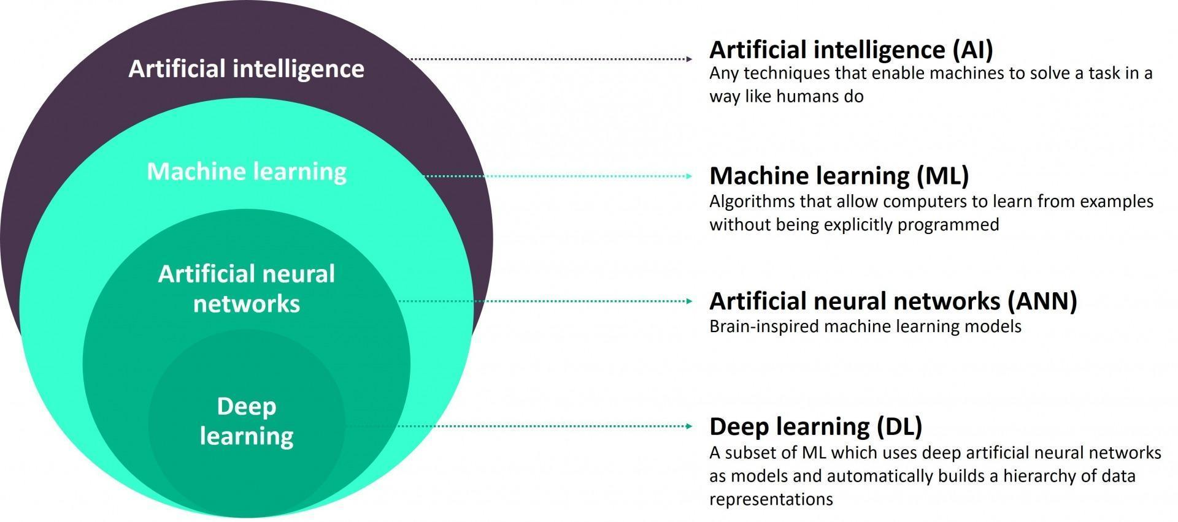
What is AI?
As a quick primer though AI, ML, ANN and DL are often mistakenly used synonymously the are all different
Image: https://www.bbntimes.com/science/artificial-intelligence-vs-machine-learning-vs-artificial-neural-networks-vs-deep-learning
Notes:
In essence, AI is the overarching concept of creating intelligent machines, ML is a subset of AI focused on machine learning algorithms, ANN is a type of algorithm used in machine learning, and DL is a subset of ML involving deep neural networks. They all contribute to the advancement of technology that can perform tasks that were previously only achievable by humans.
AI is the broad field of computer science dedicated to creating machines or software that can perform tasks that would normally require human intelligence. It aims to simulate human-like thinking processes.
ML is a subset of AI that focuses on the development of algorithms and models that enable computers to learn from data. Instead of being explicitly programmed, systems using ML algorithms improve their performance by learning from experience.
ANNs are a specific class of algorithms within the field of machine learning. They are inspired by the structure and function of the human brain's interconnected neurons. ANNs consist of layers of interconnected nodes (neurons) and are used for tasks such as pattern recognition, image and speech recognition, and more.
DL is a specialized subfield of machine learning that uses deep neural networks with many interconnected layers (hence "deep"). These networks are capable of automatically learning intricate features and representations from large amounts of data. DL has revolutionized tasks like image and speech recognition, natural language processing, and more.

Slide 13
Timeline of NLP
Neural NLP
This distinction is important to know when looking at how NLP has evolved over time
Symbolic NLP 1950s – early 1990s
Statistical NLP
1990s–2010s
Neural NLP
2010s - present
Image: https://www.bbntimes.com/science/artificial-intelligence-vs-machine-learning-vs-artificial-neural-networks-vs-deep-learning
Notes:
Here's a brief timeline of key developments in the field of Natural Language Processing (NLP):
In the 1950s - 1960s early work in NLP focused on symbolic rule-based systems. Researchers like Alan Turing and Noam Chomsky contributed foundational concepts.
In the early 1990s Statistical methods gained popularity, with probabilistic models applied to language tasks. IBM's "Candide" system demonstrated the use of statistical techniques for machine translation.
This was complimented by large-scale text corpora and the rise of the internet spurred research in statistical and machine learning approaches. Hidden Markov Models (HMMs) and Maximum Entropy Models gained traction
In the 2010s: The rise of deep learning and neural networks revolutionized NLP. Word embeddings (e.g., Word2Vec, GloVe) improved semantic understanding. Models like Recurrent Neural Networks (RNNs) and Transformers (e.g., BERT, GPT) achieved state-of-the-art results across various tasks.
More recently continued advancements in transformers and pre-trained language models have led to even more accurate and contextually aware language processing. NLP models are being used extensively in real-world applications like chatbots, language translation, and content generation.

Slide 14
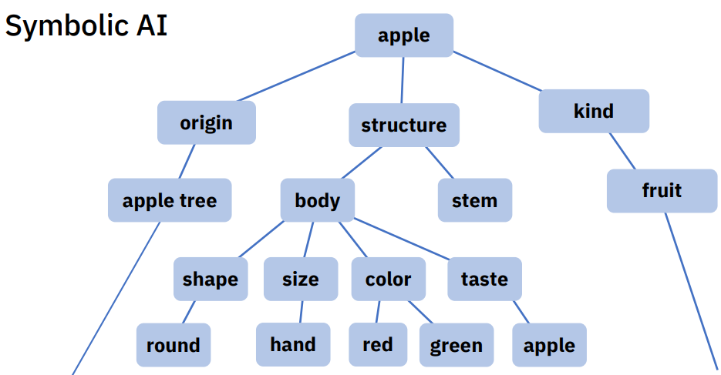
Symbolic NLP
Symbolic NLP can be achieved by using a collection of rules, such as a phrasebook with question-answer pairs
The computer applies these rules to the data it encounters, allowing it to emulate various natural language processing tasks and comprehend the language effectively
Image: https://datafloq.com/read/neuro-symbolic-ai-coming-together-two-opposing-ai-approaches/

Slide 15
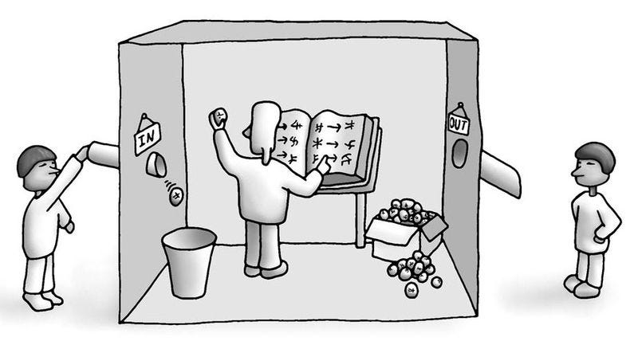
Symbolic NLP - Chinese Room
John Searle's Chinese room experiment
Image: https://analyticsindiamag.com/chinese-room-experiment-genereal-ai/
Notes:
Searle's primary inquiry centers around a fundamental question: Does the machine genuinely possess a comprehension of the Chinese language, or is it merely replicating the appearance of such understanding?
Searle's thought experiment unfolds in the following manner: Imagine a sealed room occupied by an individual who lacks knowledge of the Chinese language. In this room, there exists a compilation of Mandarin characters along with a set of guidelines meticulously outlined in a guidebook. However, this guidebook does not provide any insight into the meanings of these characters. Now, picture that we transmit a string of Mandarin characters through an aperture in the wall to this individual, with the intention that he will complete the sequence by applying the rules he has acquired. The string we transmit is akin to a "question," and the subsequent completion of the sequence represents an "answer." Remarkably, this individual who lacks fluency in Chinese becomes so proficient in this sequential task that even a native Chinese speaker would be unable to distinguish any disparity between the answers provided by this individual within the confines of the sealed room.

Slide 16
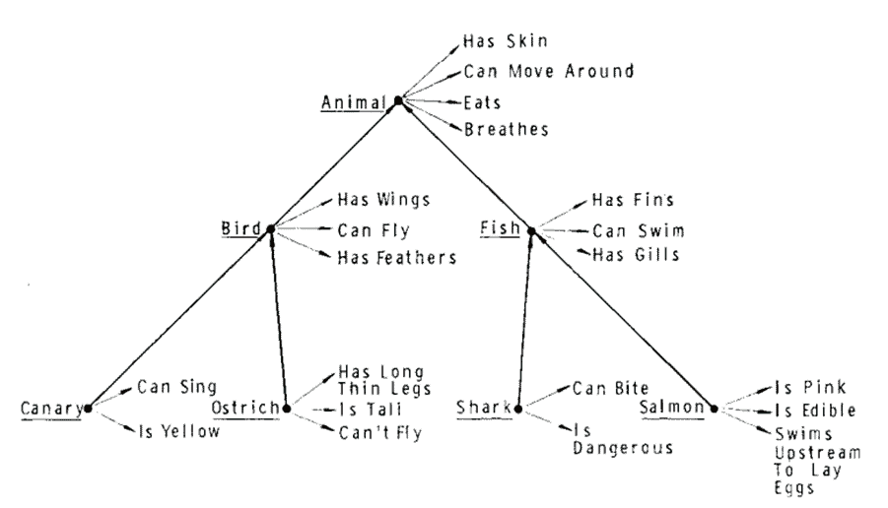
Symbolic NLP - Taxonomies
Image: https://www.aiperspectives.com/natural-language-processing/#523_Symbolic_NLP_research_tools
Notes:
In the late 1960s, tCollins and Quillian (1969) proposed a representation for word meaning as a model of how people represent concepts in memory known as a semantic network. Their theory was based on concepts structured as a taxonomy, i.e. a hierarchical representation of concepts plus facts for each concept. An example portion of such a taxonomy is shown in the figure.
However, this theory when it was shown to be incomplete by a number of researchers and though taxonomies lost traction they support a very specific form but a very important form of reasoning known as first-order logic. Referring back to the semantic network diagram, if we’re told that Bob is a Shark, we can make a number of other inferences about Bob based on the knowledge of the world embedded in the semantic network.

Slide 17
Symbolic NLP - Lexicon based
Word | AFINN Sentiment Score
Happy | +3
Sad | -2
Love | +3
Hate | -3
The lexicon-based approach is a specific technique within symbolic NLP that relies on using lexicons or dictionaries to analyze and process language
In this approach, a lexicon contains lists of words or phrases with associated information, such as sentiment scores or part-of-speech tags
Notes:
Lexicons are often used in sentiment analysis, where words in a text are looked up in the lexicon to determine their sentiment polarity (positive, negative, neutral). Sentiment lexicons assign pre-defined sentiment scores to words, and the overall sentiment of the text is computed based on the aggregated scores of the words.
The AFINN (A FINN-based Lexicon) is a widely used sentiment lexicon that assigns pre-computed sentiment scores (polarity) to words. The scores range from -5 to +5, where negative scores represent negative sentiment, positive scores represent positive sentiment, and a score of 0 represents neutral sentiment. Here's an example table with a few sample words and their corresponding AFINN sentiment scores.
While rule-based systems can be effective for certain NLP tasks and relatively simple use cases, they have limitations in handling the complexity and variability of natural language
As a result, more advanced NLP techniques, becameme prevalent, as they can learn patterns and relationships from large amounts of data, making them more adaptable and capable of handling more sophisticated language understanding tasks.

Slide 18
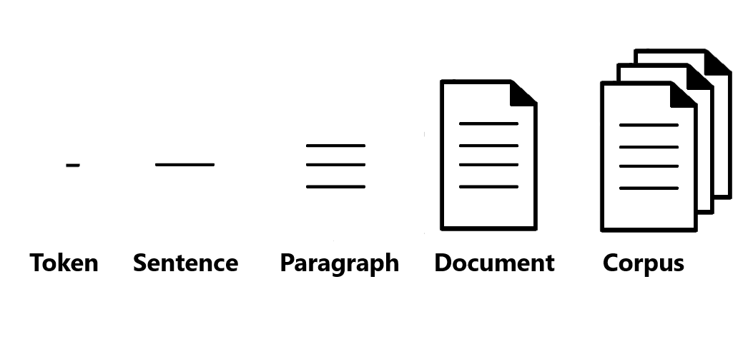
Statistical NLP
In the late 1980s, machine learning for NLP was facilitated by advancements in computational power and a shift to corpus linguistics-based approached
Image: https://www.analyticsvidhya.com/blog/2022/03/learn-basics-of-natural-language-processing-nlp-using-gensim-part-1/
Notes:
The corpus linguistics-based approach relies on the analysis of large collections of real-world text data, known as corpora. A corpus is a vast and structured collection of texts, representing actual language usage from various sources like books, articles, websites, conversations, and more.
By leveraging vast amounts of textual data from corpora, NLP systems can learn from examples and generalize patterns, leading to more accurate and adaptable language understanding and generation.

Slide 19
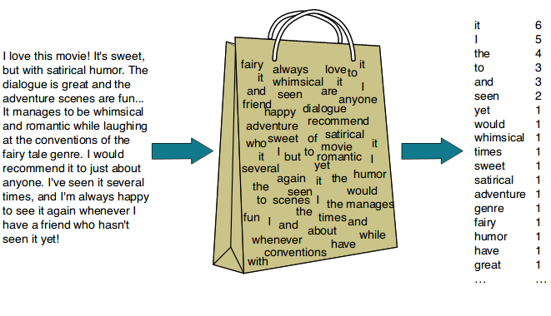
Statistical NLP -BoW
Statistical NLP often uses sparse and hand-crafted features, such as n-grams, bag-of-words, and TF-IDF to represent words as vectors
Image: https://koushik1102.medium.com/nlp-bag-of-words-and-tf-idf-explained-fd1f49dce7c4
Notes:
The Bag of Words (BoW) is a simple and widely used technique in Natural Language Processing (NLP) for representing textual data as numerical vectors. It is called "bag of words" because it disregards the order and structure of words in a sentence or document and focuses solely on their occurrence frequency.
In the Bag of Words model, a corpus of text (collection of documents) is represented as a matrix, where each row corresponds to a document, and each column corresponds to a unique word (or token) in the entire corpus. The cells of the matrix contain the frequency of each word in each document.
The BoW model is commonly used for text classification, sentiment analysis, and other tasks where the frequency of words is informative. However, it may not be suitable for tasks that require a deeper understanding of language, such as machine translation or language generation. More advanced techniques, such as word embeddings and sequence models (e.g., recurrent neural networks and transformers), have been developed to address some of the limitations of the Bag of Words model in capturing semantics and context in language data.

Slide 20
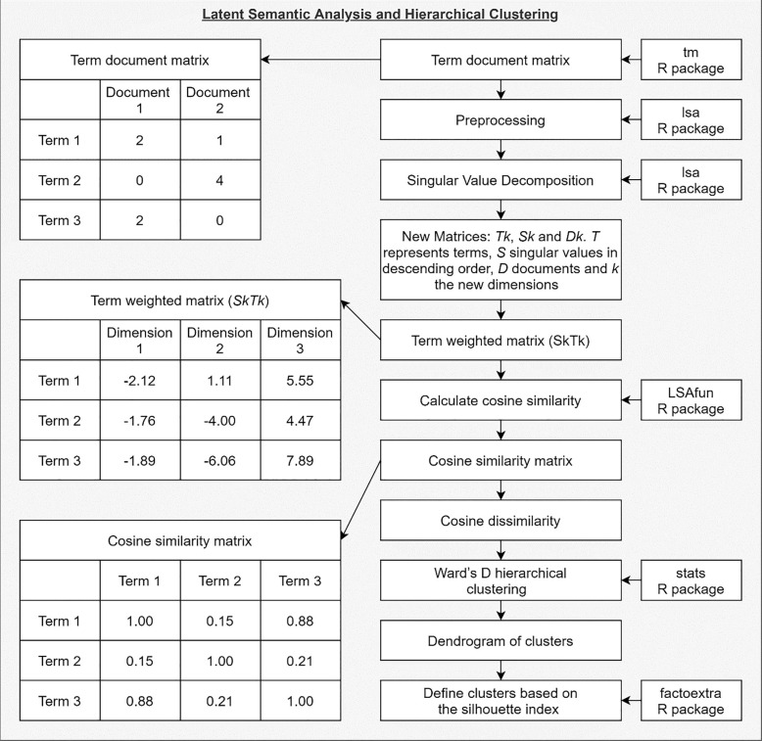
Statistical NLP - LSA
Latent Semantic Analysis (LSA) is a technique used in natural language processing and information retrieval to uncover hidden relationships between words in a large corpus of text
Here, Singular Value Decomposition (SVD) was used to transform the original high-dimensional space of words into a lower-dimensional space, where the latent (hidden) semantic structure is revealed
Image: https://www.sciencedirect.com/science/article/pii/S2212041621000863
Notes:
This is a figure from one of my papers demonstrating the numerous steps needed to carry out topic clustering when using the statistical NLP approach.
By reducing the dimensionality, this allows LSA to capture underlying meanings and associations among words, making it useful for tasks like document similarity, information retrieval, and topic modeling.
In this example we used the cosine similarity matrix to cluster words from social media post to get a collection of topics that I showed in my introductory slides.

Slide 21
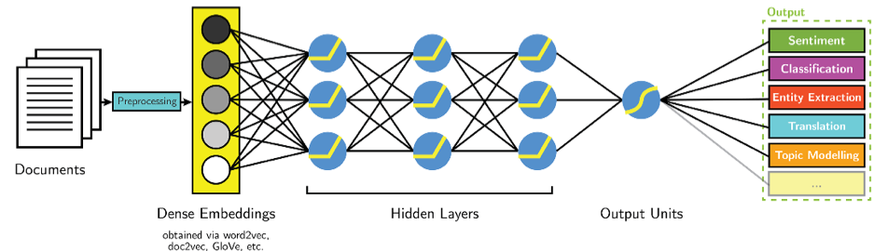
Neural NLP
Around 2015, there was a significant advancement in NLP with the introduction of neural networks, particularly in the form of deep learning models, which can automatically learn representations from data without explicit feature engineering
Notes:
Statistical NLP requires the manual engineering of relevant features, which can be time-consuming and challenging. One crucial innovation that Neural NLP took, was the shift to using word embeddings. Word embeddings are dense vector representations of words. Word embeddings capture the semantic meaning of words and their relationships with other words in the context of a given dataset. This allows the neural networks to understand the context and meaning of words better, enabling more accurate language processing.

Slide 22
Word embedding
Word embeddings allows computers to understand words like we humans by representing words as points in a multi-dimensional space
For example, let's take the words "cat" and "dog", if these words have similar meanings or are used in similar contexts, their points in the space will be closer
Once the algorithm has learned these relationships, it creates numerical representations (vectors) for each word
These vectors encode the semantic meaning of the words. Since the vectors are in a high-dimensional space, they capture the complex relationships between words
Notes:
Very, very brief explanation.

Slide 23
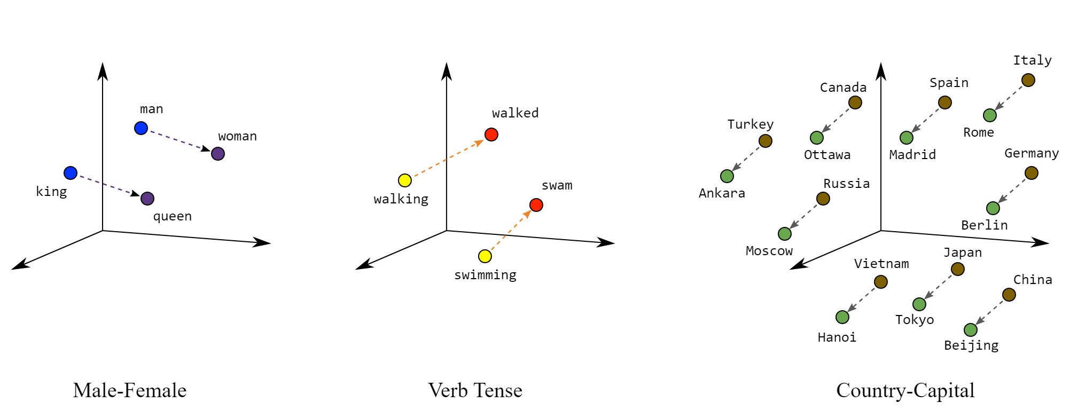
Word Embedding Example
Image: https://developers.google.com/machine-learning/crash-course/embeddings/translating-to-a-lower-dimensional-space
Notes:
Even a small multi-dimensional space can group semantically similar items together and keep dissimilar items far apart. Position (distance and direction) in the vector space encodes the semantics. The following real embeddings shows the geometrical relationships that capture semantic relations like the relation between a country and its capital.

Slide 24
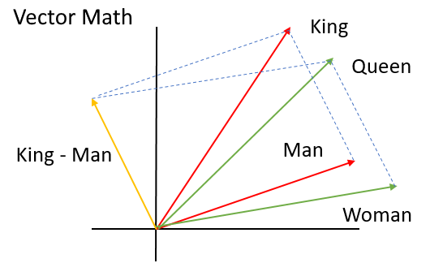
Word Embedding Example
Image: https://gagantalreja.medium.com/creating-word-embedding-using-word2vec-18904a01c812
Notes:
The "king," "queen," "woman," and "man" word embedding example is a classic demonstration of how word embeddings capture semantic relationships between words. In this example, the word embeddings represent the gender relationship between these four words.
Imagine we have trained a word embedding model on a large corpus of text. After training, the model will have learned the relationships and associations between different words based on their usage in the text. Let's assume that this model has learned to represent words in a two-dimensional space for simplicity.
The model has learned that "king" and "queen" are closely related because they both represent royal figures. Their embeddings are very close to each other, indicating their semantic similarity.
The model has also learned that "man" and "woman" are associated with gender roles. Again, their embeddings are very close to each other, indicating their semantic similarity.
Word embeddings can also be used to perform analogies. If, we take the vector difference between "king" and "man," and then add it to "woman," the result should be close to "queen." This means the model can perform the analogy "king is to man as queen is to woman“.

Slide 25
Introduction to Transformer Models

Slide 26
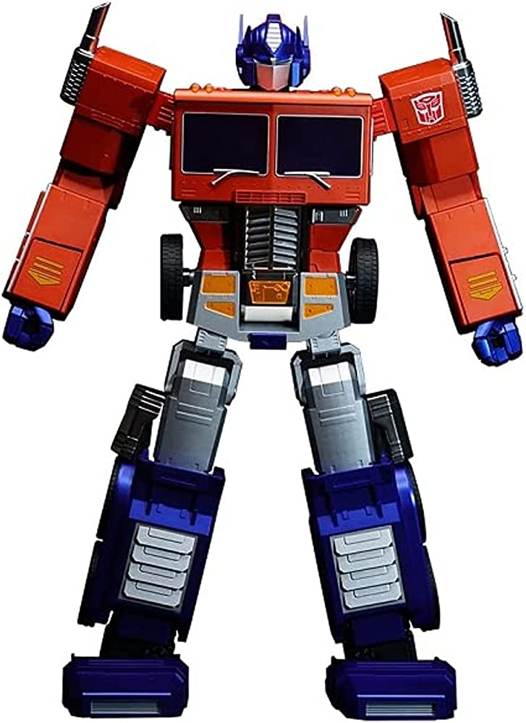
Introduction to Transformer Models
Transformer-based models have revolutionized NLP in recent years, enabling significant improvements in performance and capturing complex linguistic patterns
The influential paper "Attention Is All You Need," published in 2017, was the catalyst for the adoption of Transformers in NLP
To understand how transformer models revolutionized NLP, let's take a quick detour and look at the limitations of the main predecessors:
Recurrent Neural Networks (RNNs)
Long short term memory network (LSTMs)
Image: https://www.amazon.com/Transformers-Optimus-Prime-Auto-Converting-Robot/dp/B09JHGFXV1
Notes:
Very, very brief explanation.

Slide 27
Order of Words
In speech the order of words matter, two sentences containing the exact same words in a different order will have completely different meanings, for example:
"I saw a cat chasing a dog.“ / "I saw a dog chasing a cat.“
This is also important to note for translational tasks, for example:
English: "I am not tired.“ / Spanish: “Yo no estoy cansado."
The word order is different in the translation. In English we say “I am not tired”, while in Spanish you would say “I not am tired”
Notes:
Very, very brief explanation.

Slide 28
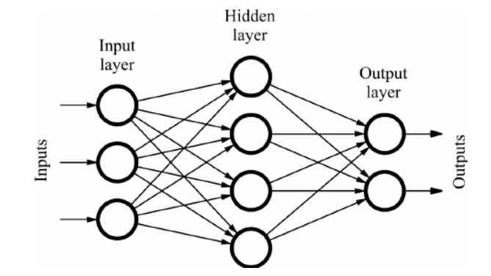
Feed-forward Neural Network
Image: https://www.quora.com/What-is-the-difference-between-LSTM-RNN-and-sequence-to-sequence
Notes:
As the name suggests, you only feed the input in the forward direction, that is, the output from one unit is only fed to units further ahead.

Slide 29
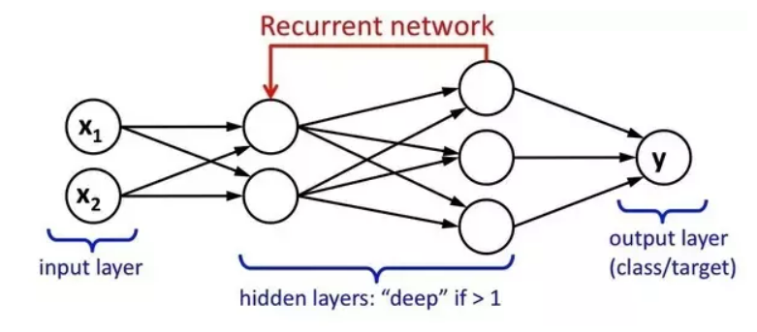
RNN limitations
RNN are sequential – however in language the order of words matter. If you wanted to translate some text, RNNs take the input of the words and one by one provide the translation
When processing long sequences, RNNs tend to lose attention or forget relevant information from the beginning of the sequence as they propagate information through time
Image: https://www.quora.com/What-is-the-difference-between-LSTM-RNN-and-sequence-to-sequence
Notes:
On the other hand, an RNN looks something like this: that is, there are loops in the network graph, and the output of one unit may go back to one of the already visited units.
The sequential nature of RNNs also means that they cannot be parallelized making them slower to run
In respect to RNN, a gradient refers to the rate of change of the loss function with respect to the model's parameters (weights and biases). It quantifies how much the loss function would change if we make small adjustments to the model's parameters
During the training process, the goal of the RNN is to minimize the loss function, which measures the discrepancy between the predicted outputs and the actual target values. To achieve this, the RNN uses an optimization algorithm called backpropagation to compute the gradients of the loss function with respect to each parameter.
However, during backpropagation to common complications can occur. First, exploding gradients are when the algorithm, without much reason, assigns a high importance to the weights, causing values to go to infinity exponentially fast, and causing their their value to becomes a NaN due to the unstable process. Second we can have vanishing gradients which occur when the values of a gradient are too small and the model stops learning or takes way too long as a result.
Both exploding gradients and vanishing gradients can occur during backpropagation, thus limiting attention for long sequences

Slide 30
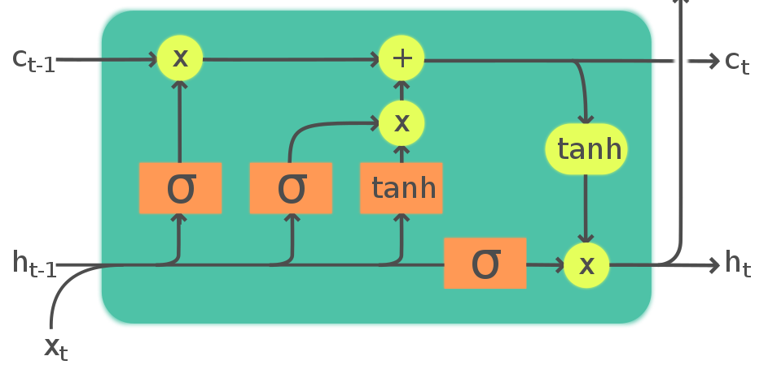
LSTMs limitations
LSTMs are a type of RNN that overcome the issues of exploding and vanishing gradients
LSTMs introduced “cell state” which acts as a "memory" for the RNN, allowing it to retain relevant information from earlier time steps and utilize it in subsequent predictions
Image: https://en.wikipedia.org/wiki/Long_short-term_memory
Notes:
Long Short-Term Memory (LSTM) is a type of recurrent neural network (RNN), a specialized architecture designed to process sequences of data like time series or text. What sets LSTM apart is its ability to effectively handle long-range dependencies and combat the vanishing gradient problem, which can hinder traditional RNNs from learning from distant past inputs.
LSTM accomplishes this by incorporating memory cells and a set of gates that regulate information flow. These gates include the input gate, forget gate, and output gate. The input gate controls new input information, the forget gate manages which information should be discarded from the memory cell, and the output gate regulates the output based on the current input and the memory cell's content.
Though the cell state improved LSTMs long-term memory, it was still limited in training and applying to extremely long pieces of text. Furthermore, due to their additional complexity, LSTMs are also much slower than RNNs.
Limited interpretability: LSTMs are often seen as "black-box" models, making it difficult to interpret and understand their decision-making process.

Slide 31

Transformer Architecture
This is the original representation of a transformed published in the 2017 "Attention Is All You Need," paper
“We propose a new simple network architecture, the Transformer, based solely on attention mechanisms, dispensing with recurrence and convolutions entirely.”
However, the model architecture might not automatically look simple to understand - let's break down the architecture into a simple overview
Image from: https://arxiv.org/pdf/1706.03762.pdf
Notes:
Very, very brief explanation.

Slide 32
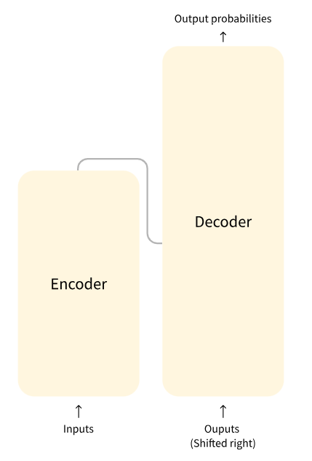
Transformer Architecture
At the highest level transformer models are made up of encoders and decoders
The encoder's job is to convert an input sequence into a sequence of continuous representations. This transformed sequence is then passed to the decoder
On the right half of the architecture, the decoder takes the encoder's output along with its own previous output to generate the final output sequence
Note: Some models are encoder only and some decoder only
Image from: https://huggingface.co/learn/nlp-course/chapter1/4?fw=pt
Notes:
Very, very brief explanation.

Slide 33
So why Transformer Models?
Three main improvements introduced by transfer models
Positional Encoding
Attention
Self-Attention Mechanism
Note: attention had been used before – self attention is the real innovation here
Image from: https://arxiv.org/pdf/1706.03762.pdf
Notes:
Positional Encoding: It provides positional information to the model, allowing it to understand word order and overcome the lack of inherent sequence information in transformers
Attention: Neural network structure that allows the text model to look at every sentence in the original input sentence when making a decision about the output
Self-Attention Mechanism: It enables the model to weigh the importance of different words in a sentence by attending to all words simultaneously, capturing both local and global dependencies

Slide 34
Positional Encoding
Instead of looking at each word sequentially, before you feed your input into the neural network you take each input word and assign a number to it based on the position it is in the sentence
Here you are storing information about word order itself in the data, not the structure of the network
Then as you train the network, it learns to interpret those positional encodings, thus learning the importance of word order from the data
The | cat | was | black
1 | 2 | 3 | 4
Notes:
Very, very brief explanation.

Slide 35
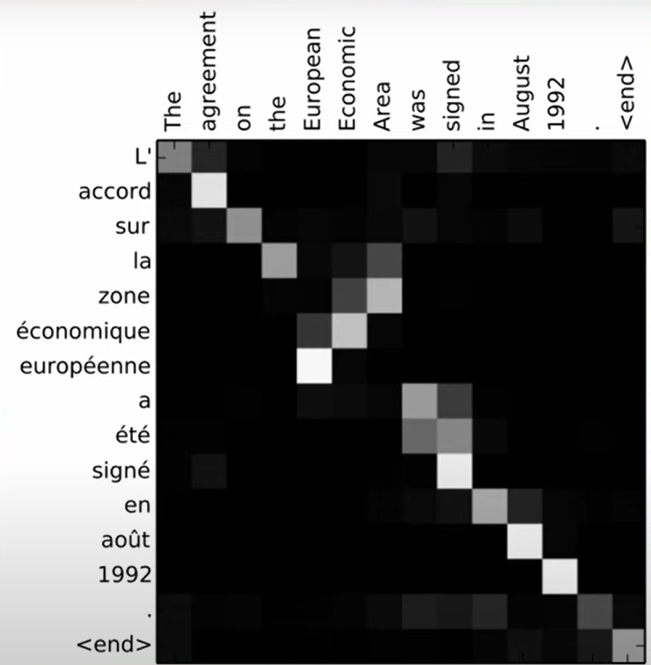
Attention
In this example, the word alignments between English and French exhibit predominantly monotonic patterns, with strong weights along the diagonal of each matrix (the lighter the square the more attention the model is paying to that line)
However, non-monotonic alignments are also noticeable, particularly with adjectives and nouns. For instance, because the French translation of European Economic Area (zone economique européenne) is reversed the model is paying attention in a reversed way
Image from: https://arxiv.org/pdf/1409.0473.pdf
Notes:
Very, very brief explanation.

Slide 36
Self Attention
In the following example the word bat means two different things. We know this as we can see the context of the surrounding words.
“The baseball player swung the bat with great precision,”
“A bat uses echolocation to navigate and locate prey in the dark”
Self attention allows a neural network to understand a word in the context of the words around it. So when a model process the word bat in the first sentence it might be “attending” to the word baseball which helps it disambiguate the baseball bat from the mammal
Notes:
Self-attention allows a model to focus on important parts of the input sequence while making predictions. Attention is extremely useful when the model can use it on the input text itself

Slide 37
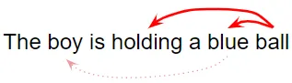
Self Attention
Self attention also allows the model to focus on which other words in the input are closely related to that word. For example:
“The lady was walking her big fluffy dog”
Here, by relating every word in the input sequence to every other word, the model can distinguish that ‘dog’ is closely related to ‘ big’ and ‘fluffy’, while, ‘fluffy’ is not related to ‘lady’
Or another example:
‘Ball’ is closely related to ‘blue’ and ‘holding’. On the other hand, ‘blue’ is not related to ‘boy’.
Image and example: https://towardsdatascience.com/transformers-explained-visually-part-1-overview-of-functionality-95a6dd460452
Notes:
Very, very brief explanation.

Slide 38
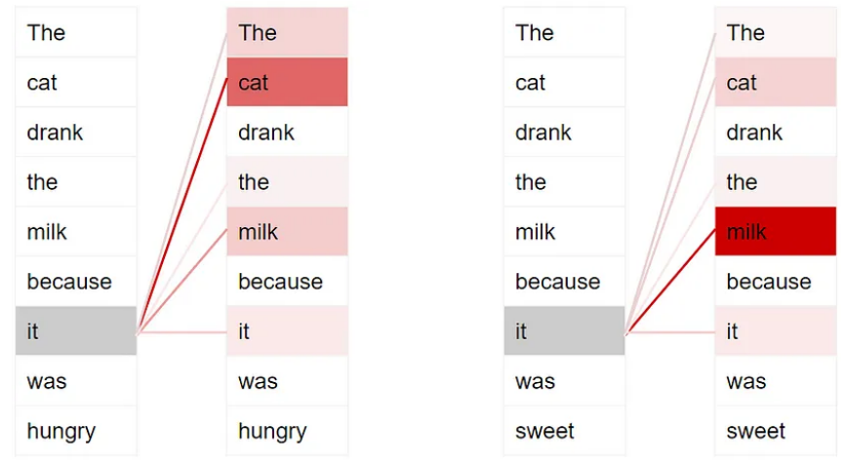
Self Attention
Another example of how self attention is useful is by understanding which aspect of a sentence a pronoun is referring to
“The cat drank the milk because it was hungry.”
“The cat drank the milk because it was sweet.”
Image and example: https://towardsdatascience.com/transformers-explained-visually-part-1-overview-of-functionality-95a6dd460452
Notes:
In the initial sentence, the pronoun 'it' refers to 'cat', while in the following sentence, 'it' refers to 'milk.' When the model encounters 'it', self-attention provides additional context, enabling the correct association ‘of it' with the appropriate word

Slide 39
Encoders
The transformer encoder processes the input sequence, such as a sentence, and converts it into a sequence embeddings. The transformer encoder comprises of 6 identical layers, each with two sublayers
Sublayer 1: Multi-Head Self-Attention
Sublayer 2: Fully Connected Feed-Forward Network
The encoder applies the same linear transformations to all words in the input sequence, but each layer uses distinct weights (W1, W2) and biases (b1, b2) , empowering the model to capture rich context and represent the input sequence comprehensively
Image from: https://arxiv.org/pdf/1706.03762.pdf
Notes:
Sublayer 1: Multi-Head Self-Attention
Allows the model to weigh the importance of each word in the sequence relative to other words
Process linearly projected queries, keys, and values to generate parallel outputs
Sublayer 2: Fully Connected Feed-Forward Network
Consists of two linear transformations with Rectified Linear Unit (ReLU) activation in between
Enables effective feature extraction and nonlinear transformations for more complex representations

Slide 40
Decoders
The decoder is responsible for generating the output sequence based on the encoder's representations and the previous output of the decoder stack . The decoder also consists of a stack of 6 identical layers, though the here each layer is composed of three sublayers
Sublayer 1: Multi-Head Self-Attention with Masking
Sublayer 2: Multi-Head Self-Attention
Sublayer 3: Fully Connected Feed-Forward Network
The transformer decoder generates output based on the encoder's representations and previous decoder outputs. The attention mechanisms ensure contextually meaningful and unidirectional predictions
Image from: https://arxiv.org/pdf/1706.03762.pdf
Notes:
Sublayer 1: Multi-Head Self-Attention with Masking
Receives previous decoder output and positional information
Implements unidirectional attention, focusing only on preceding words
Uses masking to suppress connections to future words
Sublayer 2: Multi-Head Self-Attention
Queries from previous decoder layer
Keys and values from encoder's output
Enables attention to all input words
Sublayer 3: Fully Connected Feed-Forward Network
Nonlinear transformations for feature extraction
https://machinelearningmastery.com/the-transformer-model/

Slide 41
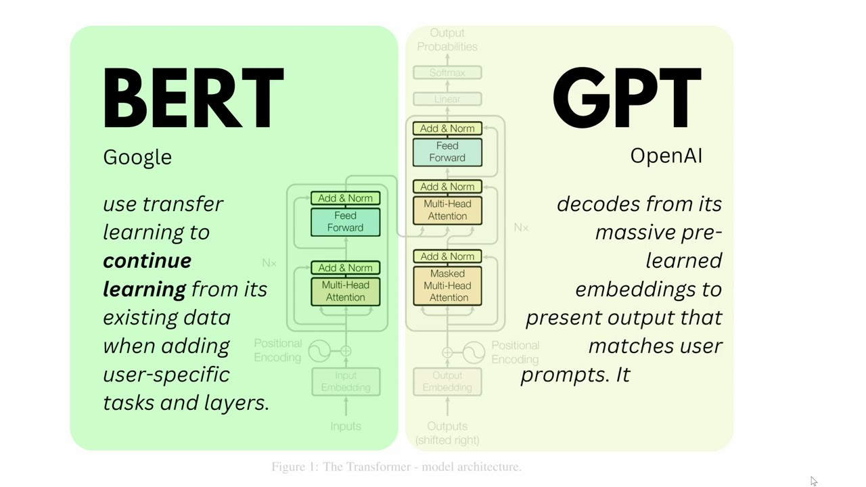
Encoder VS Decoder Models
Image from: https://www.youtube.com/watch?v=ewjlmLQI9kc

Slide 42
Encoder Models
Encoder models (also referred to as auto-encoding models) utilize only the encoder component of a Transformer model
During training, attention layers in these models have access to all words in the input sentence, making them "bi-directional“
The pre-training process involves corrupting sentences (e.g., masking random words) and having the model reconstruct the original sentence
Encoder models are well-suited for tasks that require understanding the full sentence, like sentence classification and NER
Image from: https://huggingface.co/learn/nlp-course/chapter1/4?fw=pt
Notes:
Encoder models: ALBERT, BERT, DistilBERT, ELECTRA, and RoBERTa

Slide 43
Decoder Models
Decoder models (also referred to as "auto-regressive" models)
exclusively employ the decoder component
During each stage of processing, the attention layers within these models can only access the words positioned before the current word in the sentence.
In the pre-training phase, decoder models focus on predicting the next word in the sentence
Decoder models are well-suited for tasks that involve text generation
Image from: https://huggingface.co/learn/nlp-course/chapter1/4?fw=pt
Notes:
Decoder models: CTRL, GPT, GPT-2, and Transformer XL

Slide 44
Encoder-Decoder Models
Encoder-decoder models, (also referred to as sequence-to-sequence models), use both encoder and decoder components in the Transformer architecture
The encoder's attention layers have the capability to access all words in the initial sentence, making it "bi-directional”. While the decoder’s attention layers are restricted to accessing only the words positioned before a given word in the input sequence
Encoder-decoder models are best suited for tasks revolving around generating new sentences depending on a given input, such as summarization, translation, or generative question answering
Image from: https://huggingface.co/learn/nlp-course/chapter1/4?fw=pt
Notes:
Encoder-decoder models: BART, mBART, Marian, T5

Slide 45
Pre-trained models

Slide 46
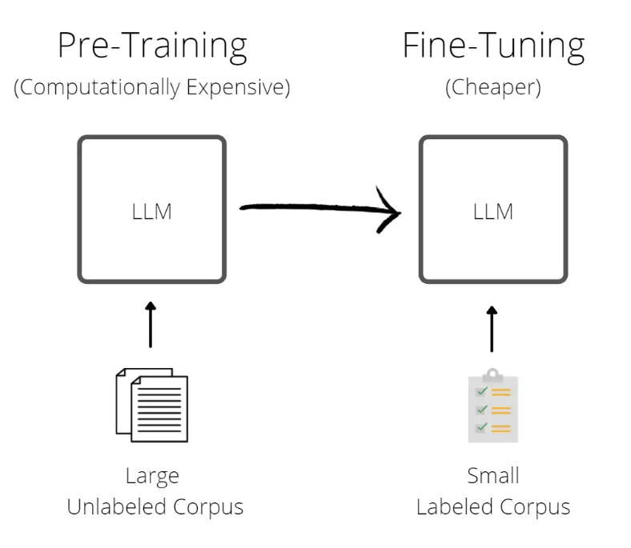
What are Pre-trained models?
Pre-trained NLP models are language models that have been pre-trained on large datasets containing vast amounts of text
These models are trained using deep learning techniques, particularly transformer-based architectures
During pre-training, these models learn to understand the relationships between words, capture context, and build rich language representations
Image: https://research.aimultiple.com/large-language-models/
Notes:
The process involves predicting missing words in sentences (masked language modelling) or predicting the next word in a sequence. By exposing the model to large-scale language patterns, it gains knowledge about grammar, semantics, and contextual cues

Slide 47
Advantages of Pre-Trained Models
There are a number of advantages to using these pre-trained models:
Ease of Use: Find a pre-trained model similar to your task and apply it, no need to build from scratch
Faster Optimization: Pre-trained models start with knowledge of good parameters, leading to quicker optimization
Reduced Data Requirements: Utilize large pre-trained models, requiring less data to achieve convergence
Image: https://research.aimultiple.com/large-language-models/
Notes:
Very, very brief explanation.

Slide 48
Pre-trained models Examples
There are a range of popular pre-trained models available to use:
BERT (Bidirectional Encoder Representations from Transformers): It uses a masked language modeling objective to learn bidirectional contextual representations.
GPT (Generative Pre-trained Transformer): It is designed for text generation tasks and uses a left-to-right autoregressive training approach
T5 (Text-To-Text Transfer Transformer,): perform tasks like translation, summarization, question answering, and more, just by providing the appropriate input text that defines the task
Notes:
Just as a recap, these all are transformer models, but belong to different types. BERT is an encoder only. GPT is a decoder only. And T5 is a encoder-decoder model.

Slide 49
Limitations
Pretrained NLP models, while highly effective, do have some limitations. Some of the key limitations include:
Domain-specific Adaptation: Pre-trained models are often trained on general text data, which may not fully align with the specific domain or task at hand
Out-of-Vocabulary Words: Pre-trained models might not handle out-of-vocabulary words well, as they are unfamiliar with rare or domain-specific terms
Overfitting and Generalization: Pre-trained models could overfit to the data they were trained on, leading to limited generalization to unseen or diverse data
Bias in Training Data: Pre-training data may reflect inherent biases present in the sources from which it was collected
Notes:
Fine-tuning may still require significant data from the target domain to achieve optimal performance
As a result, pretrained models can inherit and propagate these biases, leading to biased or unfair outputs

Slide 50
Fine-tuning a model
Fine-tuning a pre-trained model is not a straightforward process. It requires significant time and CPU resources to effectively adjust the model for the targeted task. As a result, the process of fine-tuning can be complex and resource-intensive
Image: https://research.aimultiple.com/large-language-models/
Notes:
By fine-tuning a pretrained model, we can adapt it to different NLP applications, achieving state-of-the-art results with less training data compared to building models from the ground up
For fine-tuning LLMs we use a smaller dataset specific to your target task. The new data is used to update its parameters for new settings or applications
*Because of this, fine-tuning models is out of scope of the practical session

Slide 51
Additional terms
Architecture
The skeleton of the model, defining each layer and operation within
Specifies the overall design and structure of the Transformer model
Checkpoints
Represents the weights that will be loaded into a specific architecture
Contains the learned parameters of the model after training
Model
An umbrella term that can refer to both architecture and checkpoint
As an illustration, BERT represents the model's architecture, while bert-base-cased refers to a set of specific weights trained by Google acts as a checkpoint. Both can be called models
Image from: https://arxiv.org/pdf/1706.03762.pdf
Notes:
However, both terms, "the BERT model" and "the bert-base-cased model," are suitable to use
https://machinelearningmastery.com/the-transformer-model/

Slide 52
Introduction to BERT

Slide 53
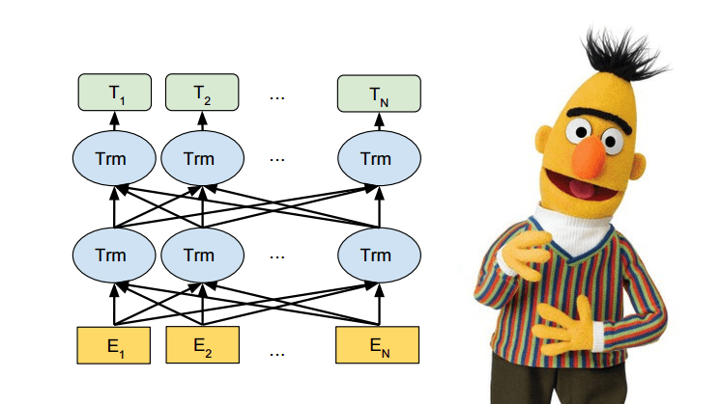
Introduction to BERT
BERT, which stands for Bidirectional Encoder Representations from Transformers, was introduced by Google's researchers in 2018
Original BERT paper: https://arxiv.org/abs/1810.04805; Image: https://medium.com/analytics-vidhya/what-is-bert-e758ee2b2ab5
Notes:
It is a transformer-based architecture designed to understand the contextual meaning of words and sentences in a bidirectional manner, enabling it to capture both left-to-right and right-to-left contextual information
BERT revolutionized the NLP space by solving for 11+ of the most common NLP tasks (and better than previous models)

Slide 54


BERTs training
BERT was trained on a massive dataset comprising 3.3 billion words, specifically on Wikipedia (~2.5 billion words) and Google's BooksCorpus (~800 million words)
Notes:
Training on such a large dataset is time-consuming, but BERT's success was made possible by the novel Transformer architecture and the use of TPUs (Tensor Processing Units). TPUs, Google's custom circuits designed for large ML models, accelerated BERT's training significantly. Utilizing 64 TPUs, BERT was trained in just four days

Slide 55
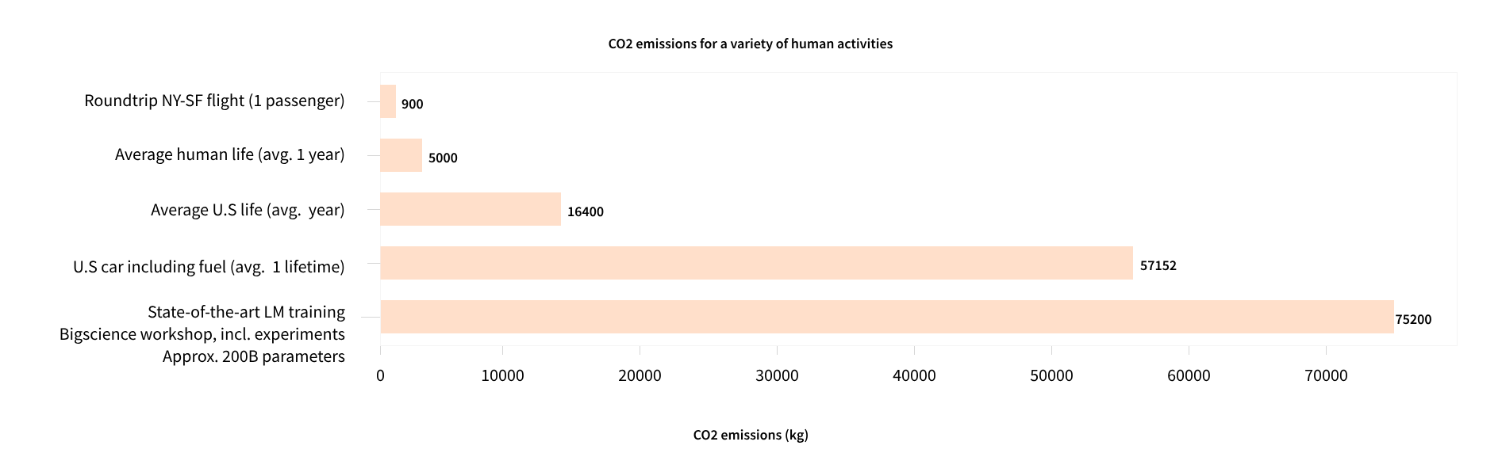
BERTs training
The process of training a model, particularly one of substantial size, demands a significant volume of data. This inevitably leads to considerable expenses in terms of both time and computational resources
Image: https://huggingface.co/learn/nlp-course/chapter1/4?fw=pt

Slide 56
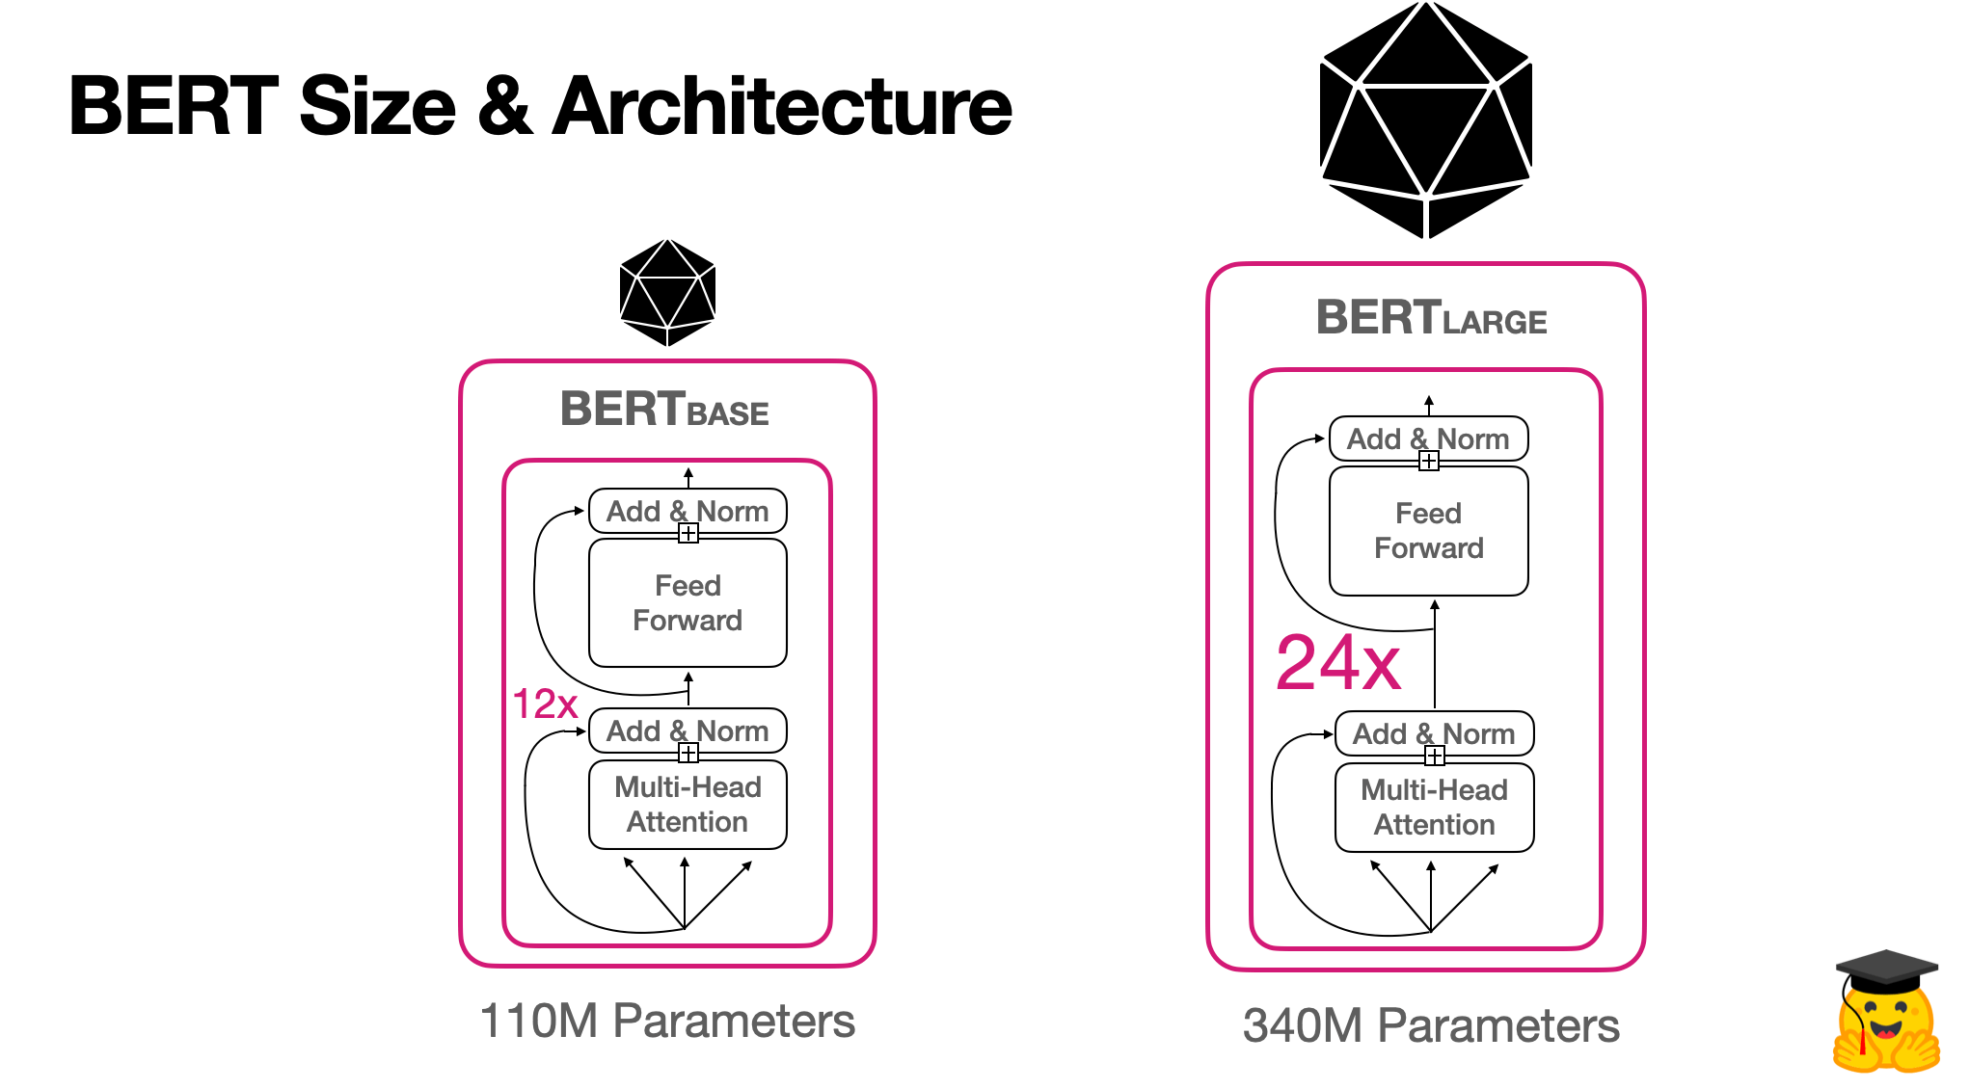
BERTs training
Instead of training a language model to predict the next word in a sentence (as in traditional language models), BERT uses two main pre-training tasks:
Masked Language Modelling (MLM)
Next Sentence Prediction (NSP)
Image from: https://huggingface.co/learn/nlp-course/chapter1/4?fw=pt
Notes:
The key innovation of BERT lies in its pre-training approach. BERT was trained 50% on MLM and 50% on NSP

Slide 57
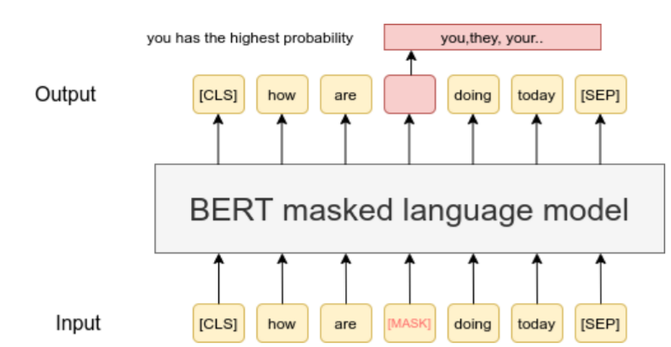
Masked Language Modelling
Image from: https://www.sbert.net/examples/unsupervised_learning/MLM/README.html
Notes:
MLM revolutionized text learning by facilitating bidirectional understanding. During training a random 15% of tokenized words were hidden, compelling BERT to predict the masked word using the context from both sides of the concealed word

Slide 58
Masked Language Modelling
MLM was a ground-breaking approach that had never been used before
Even people can be error-prone when predicting missing words, which is why language models, like BERT, are often compared to human performance
These newer models can even surpass human accuracy
For example:
“When they reached the top of the [MASK] the hiker was amazed by the breathtaking view”.
Notes:
Some of you in the audience may be filling in the mask with different words depending on your knowledge of the words. Several different words could fit in this example e.g. “mountain”, "summit," "cliff," "ridge," "hill," or "slope."

Slide 59
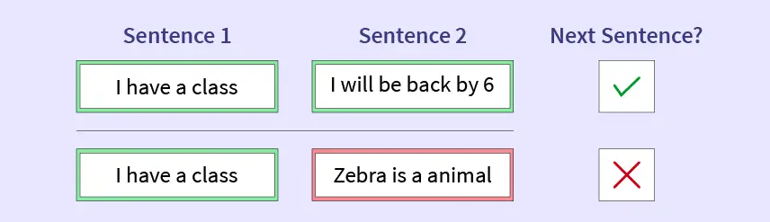
Next Sentence Prediction
To enhance BERT's understanding of sentence relationships, NSP is utilized, involving predicting if a given sentence follows the previous one
Notes:
During training, a mix of 50% correct sentence pairs and 50% random sentence pairs is employed, aiding BERT in improving its next sentence prediction accuracy

Slide 60
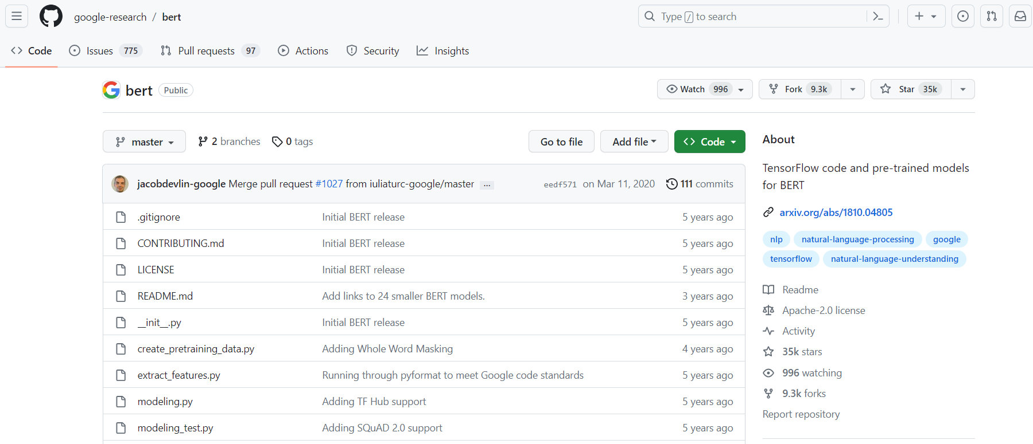
Accessing pre-trained BERT models
BERT's Source Code is Publicly Accessible on GitHub, enabling researcher to fine-tune and publish models tailored for various tasks
Notes:
Because of this there are thousands of Open-Source Pre-Trained BERT Models available for a range of tasks such as:
Text classification
Named entity recognition
Sentiment analysis
Predict toxic comments
There are also many BERT models fine-tuned for specific research cases - we will get hands on with some of these in the next session

Slide 61
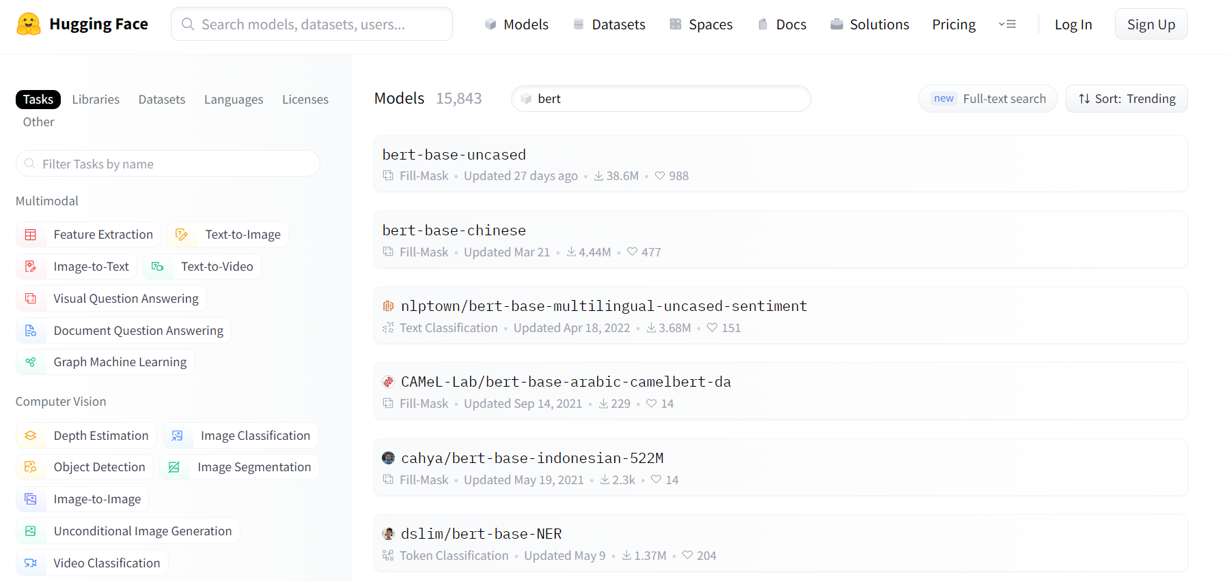
Hugging Face Hub
https://huggingface.co/models
Notes:
Very, very brief explanation.

Slide 62
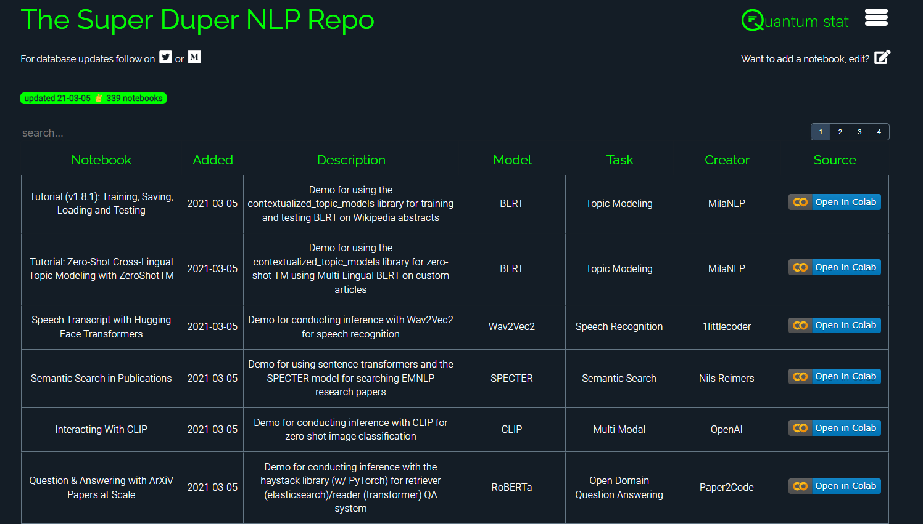
NLP Repo
https://notebooks.quantumstat.com/#/
Notes:
Very, very brief explanation.

Slide 63
Examples of domain specific models
BiodivBERT: a Pre-Trained Language Model for the Biodiversity Domain (Abdelmageed et al. 2023)
Covid-twitter-bert: A natural language processing model to analyse covid-19 content on twitter (Müller 2021)
Finbert: Financial sentiment analysis with pre-trained language models (Araci, D. 2019)
srBERT: automatic article classification model for systematic review using BERT (Aum and Choe 2021)
cybert: Contextualized embeddings for the cybersecurity domain (Ranade et al. 2021)
SciBERT: A pretrained language model for scientific text (Beltagy et al. 2019)
Legaldb: Long distilbert for legal document classification (Bambroo and Awasthi 2021)
NukeBERT: A pre-trained language model for low resource nuclear domain (Jain et al. 2020)
BioELECTRA: pretrained biomedical text encoder using discriminators (Kanakarajan, et al. 2021)
Notes:
Very, very brief explanation.

Slide 64
Research Applications

Slide 65
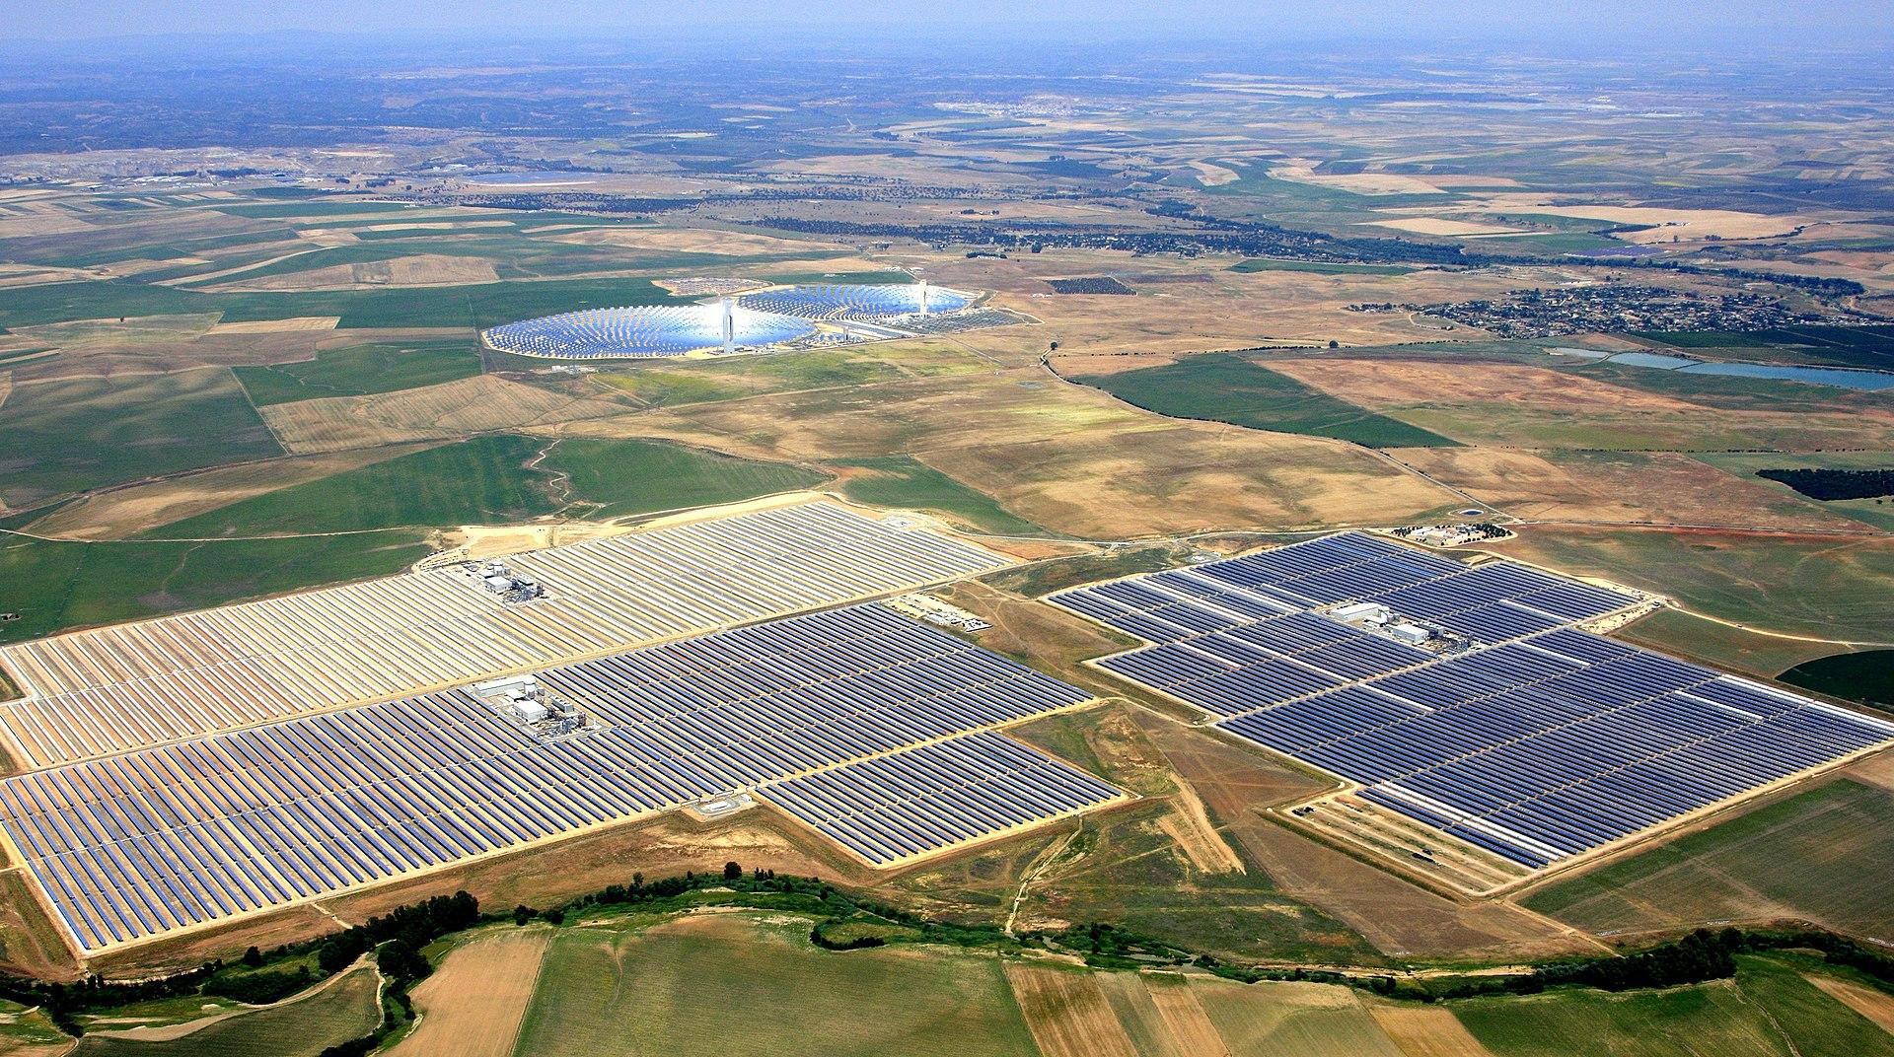
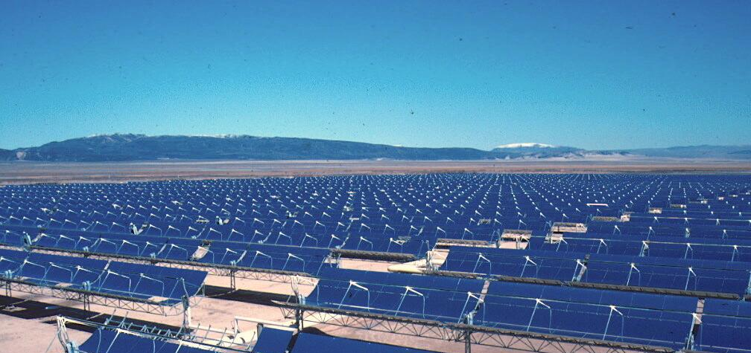
Understanding Public Sentiment
Kim et al. (2021) created a database of Tweets concerning solar energy in the US. Using a RoBERTa-based sentiment classification model their found:
“Public opinion on solar energy is more positive in states with a larger share of Democratic voters”
“Public sentiment toward solar energy is more positive in states with consumer-friendly net metering policies”
Paper: Kim et al. (2021). Sustainability, 13(5), 2673.
Notes:
We can gather large citizen sourced data sets from social media websites such as Twitter and then filter posts to a specific topic

Slide 66
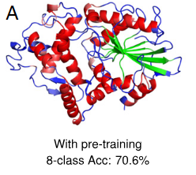
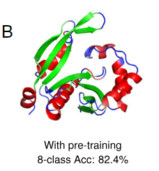
Generating unseen data
Rives et al. (2021) trained a transformer model on 86 billion amino acids across 250 million protein sequences spanning evolutionary diversity
Their results demonstrate how transformer models can generate new sequences that have not been seen before in nature but that are biologically active. This has a range of research implications:
Supervised prediction of mutational effect
Supervised prediction of secondary structure
Improving features for long-range contact prediction
Paper: Rives et al. (2021) PNAS. 118(15). E2016239118.
Notes:
Very, very brief explanation.

Slide 67
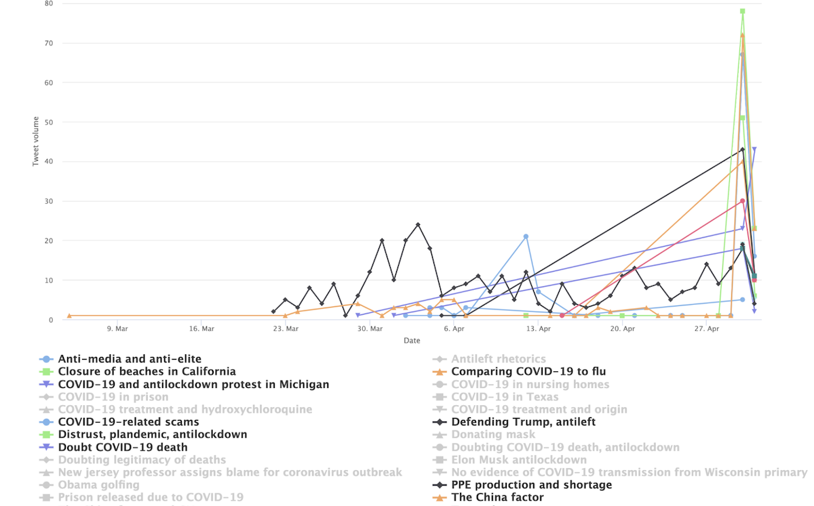
Clustering Topics
Xu et al. clustered Twitter posts concerning COVID-19 and investigated the temporal changes in these topics throughout different stages of the pandemic
Paper: Xu et al. (2022). Jmir Infodemiology, 2(2), e41198
Notes:
Very, very brief explanation.

Slide 68
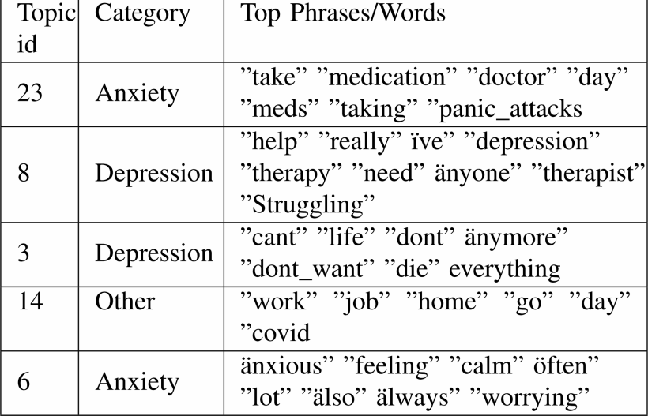
Clustering topics
Sarkar et al. (2022) et al. used posts and comments on Reddit to assess how mental health is discussed on social media
Paper: Sarkar et al. (2022). (ASONAM) (pp. 427-435). IEEE.
Notes:
Very, very brief explanation.

Slide 69
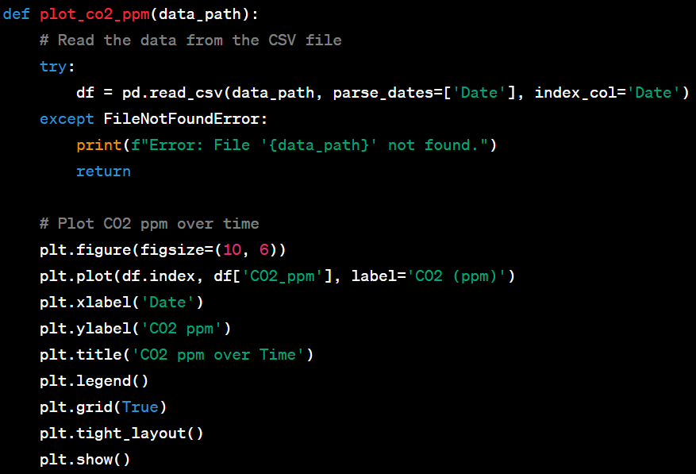
Generating Code
Climate change researchers could prompt ChatGPT to provide a Python script for predicting organic carbon aerosol concentrations based on variables such as concentrations of other aerosol pollutants and meteorological conditions
ChatGPT can also help customize code including data splitting, cross-validation, and hyperparameter optimization
Paper: Zhu, J. J. at al., (2023). Environmental Science & Technology.
Notes:
Very, very brief explanation.

Slide 70
Break time
To follow along in the hands-on lab, the workbook can be found at: https://tinyurl.com/ainlplab

Slide 71
Next Sentence Prediction
To enhance BERT's understanding of sentence relationships, NSP (Next Sentence Prediction) is utilized, involving predicting if a given sentence follows the previous one. During training, a mix of 50% correct sentence pairs and 50% random sentence pairs is employed, aiding BERT in improving its next sentence prediction accuracy.
Next Sentence Prediction Example:
Correct sentence pair: Jim went fishing. He caught a wide mouth bass.
Incorrect sentence pair: Simon likes roller coasters. Birds have feathers.
Notes:
Very, very brief explanation.

Slide 72
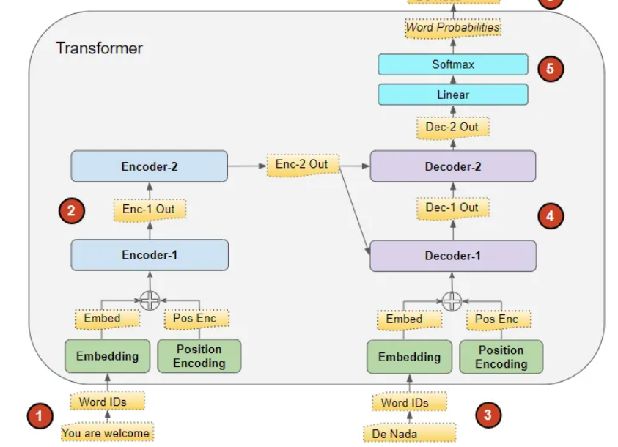
Transformer Architecture
The input sequence is transformed into Embeddings (with Position Encoding) and passed to the Encoder
The Encoder stack processes the input, generating an encoded representation of the sequence
The target sequence is prepended with a start-of-sentence token, converted into Embeddings (with Position Encoding), and fed to the Decoder
The Decoder stack processes the target sequence along with the encoded representation from the Encoder, producing an encoded representation of the target sequence
The Output layer converts the encoded representation into word probabilities, yielding the final output sequence
Image: https://towardsdatascience.com/transformers-explained-visually-part-1-overview-of-functionality-95a6dd460452
Notes:
Very, very brief explanation.

Slide 73
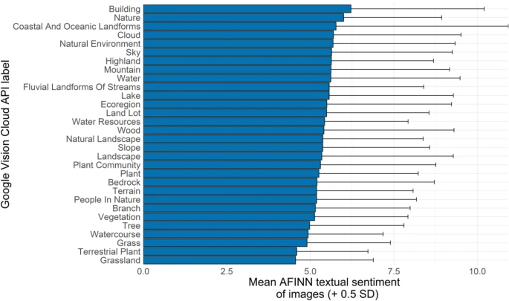
My previous NLP research
A large database of 20,910 images people took whilst hiking in Wales, UK were collected from social media
The contents of the images were automatically labelled using Computer Vision
Using a Lexicon-based approach the sentiment of these attribute was calculated to establish what features of nature contribute to a positive hiking experience
Image: https://www.sciencedirect.com/science/article/pii/S2212041621000863
Notes:
Using social media, primarily focusing on the implementation of statistical NLP - but that has all changed since I joined MIDAS - I am now harnessing cutting edge NLP methods thanks to transformers.

Slide 74
My previous NLP research
A large database of 179,700 images people took whilst hiking in the USA were collected from social media
The contents of the images were automatically labelled using Computer Vision
The descriptive words of the image contents where then clustered using a statistical NLP approach
Image: https://www.sciencedirect.com/science/article/pii/S2212041621000863
Notes:
Using social media, primarily focusing on the implementation of statistical NLP - but that has all changed since I joined MIDAS - I am now harnessing cutting edge NLP methods thanks to transformers.

Slide 75
My current NLP research
Here, I am using advanced topic modeling using the BERT transformer model to quickly and accurately classify topics conveyed in social media posts
This study is looking at identifying how people discuss wildfires in Yellowstone National Park
Notes:
By the end of the session, you should be able repeat this for any dataset of text. This is much easier to implement (and for me to teach) than the previous clustering approach.

